Slide 1
My Measurement and Ratio Interactive Notebook
Name
Class
Term 3 Semester 2

Slide 2
Contents
Formula Page
Page
Date
Description
2
3

Slide 3
Tasks
24
7
30
Essential Question
Questions
Notes
Summary
14
16

Slide 4
Write down 5 ratios equivalent to 5:1

Slide 5
24
7
30
Date
Dividing an amount into a given ratio
EQ – How are equivalent ratios used to divide an amount into a given ratio?
Example - Divide $35 in a ratio of 2:5
15

Slide 6
24
7
30
Date
Dividing an amount into a given ratio
EQ – How are equivalent ratios used to divide an amount into a given ratio?
Example - Divide $35 in a ratio of 2:5
Find the total number of parts
2 : 5 is 2+5=7 parts
15

Slide 7
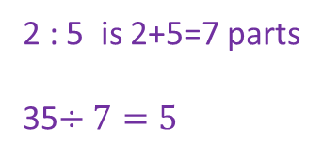
24
7
30
Date
Dividing an amount into a given ratio
EQ – How are equivalent ratios used to divide an amount into a given ratio?
Example - Divide $35 in a ratio of 2:5
Find the total number of parts
Divide the amount by the
number of parts
2 : 5 is 2+5=7 parts
35$÷7=5$
15

Slide 8
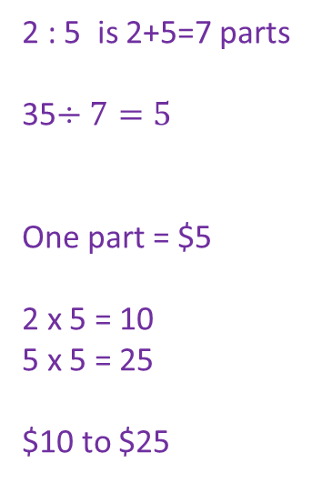
24
7
30
Date
Dividing an amount into a given ratio
EQ – How are equivalent ratios used to divide an amount into a given ratio?
Example - Divide $35 in a ratio of 2:5
Find the total number of parts
Divide the amount by the
number of parts
This gives one part
Then multiple each value
in the ratio by one part
Answer
2 : 5 is 2+5=7 parts
35$÷7=5$
One part = $5
2 x 5 = 10
5 x 5 = 25
$10 to $25
15

Slide 10
Notes Review
24, 7 ,30
Date
Title
Essential question
Notes complete
Notes complete with colour and diagrams
Questions completed
Contents page filed in
Formula page filled in

